Slide 1
STUDENT
PLANNER
Here is where your presentation begins

Slide 2
NOTES
01
NOTES
WHOA!
SCIENCE
02
SCIENCE
03
MATH
MATH
This could be the part of the presentation where you can introduce yourself, write your email…
04
BIOLOGY
BIOLOGY
05
HISTORY
HISTORY
06
EXTRAS
EXTRAS

Slide 3
NOTES
AWESOME WORDS
SCIENCE
MATH
Because key words are great for catching your audience’s attention
BIOLOGY
HISTORY
EXTRAS

Slide 4
NOTES
MONTHLY CALENDAR
SCIENCE
Sun
Mon
Tue
Wed
Thu
Fri
Sat
Week 1
1
2
3
4
5
6
MATH
Week 2
7
8
9
10
11
12
13
BIOLOGY
Week 3
14
15
16
17
18
19
20
Week 4
HISTORY
21
22
23
24
25
26
27
Week 5
28
29
30
31
EXTRAS

Slide 5
NOTES
WEEKLY PLANNER
SCIENCE
Mon
Tue
Wed
Thu
Fri
MATH
BIOLOGY
HISTORY
EXTRAS

Slide 6
NOTES
DAYLY PLANNER
SCIENCE
To Do List
09:00
10:00
MATH
11:00
BIOLOGY
Notes:
14:00
Here you can describe your most important tasks or your homework
15:00
HISTORY
16:00
EXTRAS

Slide 7
NOTES
NOTES
SCIENCE
Mercury
Mercury
Venus
MATH
BIOLOGY
Mercury is the closest planet to the Sun and the smallest one
Venus has a good name and is the second planet from the Sun
HISTORY
EXTRAS

Slide 8
NOTES
MORE NOTES
SCIENCE
Mars
Mars
Mars is a very cold place
Mars is a very cold place
MATH
BIOLOGY
Jupiter
Jupiter
Jupiter is the biggest planet
Jupiter is the biggest planet
HISTORY
EXTRAS

Slide 9
NOTES
AND STICKY NOTES
SCIENCE
Notes:
MATH
Notes:
Notes:
Here you can describe your most important tasks or your homework
Here you can describe your most important tasks or your homework
Here you can describe your most important tasks or your homework
BIOLOGY
HISTORY
EXTRAS

Slide 10
NOTES
SCIENCE PLAN
Wed
Mercury is the closest to the Sun
SCIENCE
Mercury is the closest to the Sun
MATH
Mon
Thu
Mercury is the closest to the Sun
Mercury is the closest to the Sun
Mercury is the closest to the Sun
Mercury is the closest to the Sun
BIOLOGY
HISTORY
Tue
Fri
Mercury is the closest to the Sun
Mercury is the closest to the Sun
Mercury is the closest to the Sun
Mercury is the closest to the Sun
EXTRAS

Slide 11
NOTES
SCIENCE
“This is a quote, words full of wisdom that someone important said and can make the reader get inspired.”
—Famous Scientist
MATH
BIOLOGY
HISTORY
EXTRAS

Slide 12
NOTES
MATH
SCIENCE
215
MATH
days until the holidays and counting
BIOLOGY
HISTORY
EXTRAS

Slide 13
NOTES
SCIENTIFIC COMPARISON
SCIENCE
Mercury is the smallest planet
Jupiter is the biggest planet
MATH
Option 1
30%
60%
Option 2
BIOLOGY
45%
20%
Option 3
40%
50%
HISTORY
60%
Option 4
45%
EXTRAS

Slide 14
NOTES
SCIENCE
MATH
BIOLOGY
Mars
Jupiter
Venus
Mars is a very cold place
Jupiter is the biggest planet
Venus has a beautiful name
HISTORY
EXTRAS

Slide 15
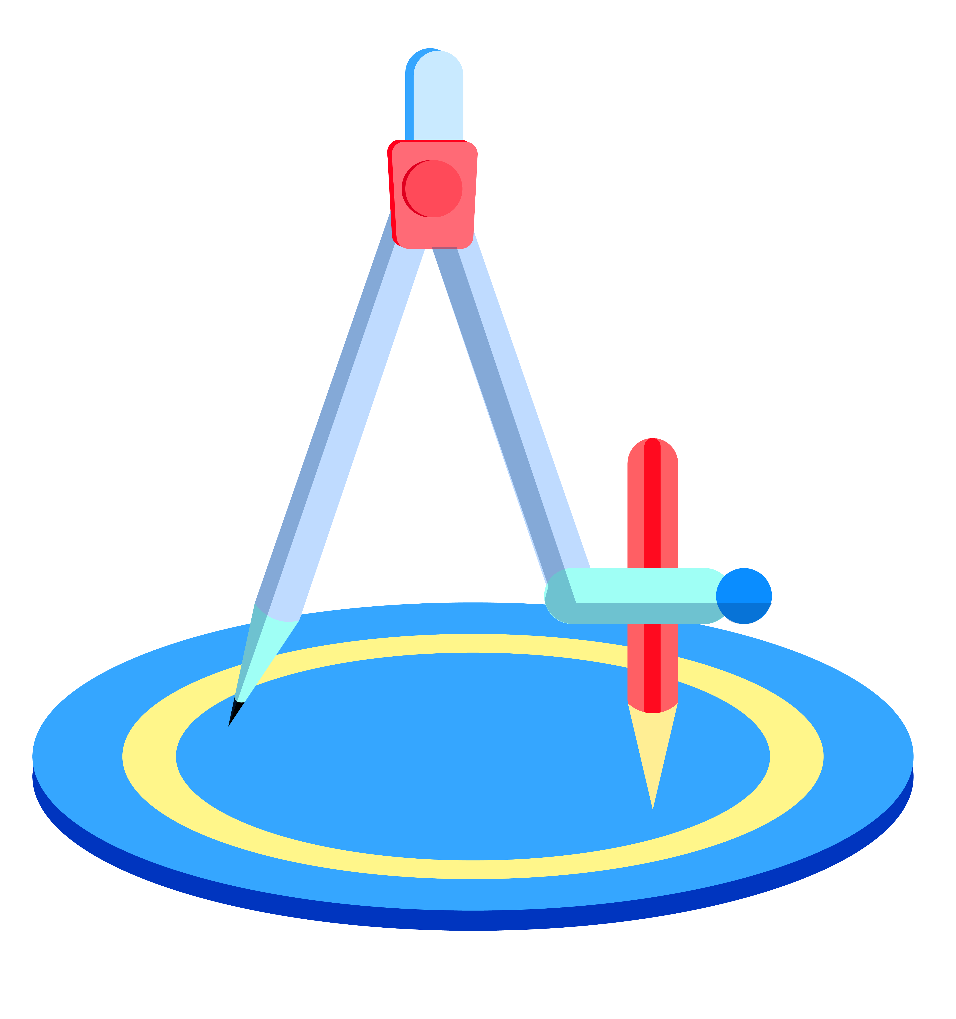
NOTES
SCIENCE
MATH
Mars
Mars
MATH
Mars is a very cold place
Mars is a very cold place
BIOLOGY
Jupiter
Jupiter
Jupiter is the biggest planet
Jupiter is the biggest planet
HISTORY
EXTRAS

Slide 16
NOTES
THIS IS A GRAPH
SCIENCE
MATH
BIOLOGY
Mars
Jupiter
Venus
Mars is a very cold place
Jupiter is the biggest planet
Venus has a beautiful name
HISTORY
To modify this graph, click on it, follow the link, change the data and paste the resulting graph here, replacing this one
EXTRAS

Slide 17
NOTES
BIOLOGICAL TIMELINE
SCIENCE
MATH
Jupiter
Jupiter
Jupiter is the biggest planet
Jupiter is the biggest planet
DAY 1
DAY 2
DAY 3
DAY 4
BIOLOGY
Venus
Mars
Venus has a beautiful name
Mars is a very cold place
HISTORY
EXTRAS

Slide 18
NOTES
PERCENTAGE OF COMPONENTS
SCIENCE
MATH
Venus
30%
Jupiter
50%
BIOLOGY
HISTORY
Mars
70%
EXTRAS

Slide 19
NOTES
BIOLOGICAL INFOGRAPHIC
SCIENCE
MATH
Mars
Mars
Mars is a very cold place
Mars is a very cold place
BIOLOGY
Mars
Mars
HISTORY
Mars is a very cold place
Mars is a very cold place
EXTRAS

Slide 20
NOTES
√
Images reveal large amounts of data, so remember: use an image instead of long texts
SCIENCE
HISTORY
MATH
?
Images reveal large amounts of data, so remember: use an image instead of long texts
BIOLOGY
×
Images reveal large amounts of data, so remember: use an image instead of long texts
HISTORY
EXTRAS

Slide 21
NOTES
SCIENCE
MATH
BIOLOGY
HISTORY
EXTRAS
A PICTURE IS WORTH A THOUSANDS WORDS

Slide 22
NOTES
THIS IS A MAP
SCIENCE
Mars
Mars is a very cold place
MATH
Jupiter
Jupiter is the biggest planet
BIOLOGY
Mars
HISTORY
Mars is a very cold place
EXTRAS

Slide 23
NOTES
EXTRA MATERIALS
SCIENCE
MATH
Mars
Mercury is the closest to the Sun
Mercury is the closest to the Sun
BIOLOGY
HISTORY
Venus
Mercury is the closest to the Sun
Mercury is the closest to the Sun
EXTRAS

Slide 24
NOTES
TEAM OF TEATHERS
SCIENCE
Helena Doe
Helena Doe
MATH
You can talk about this person here
You can talk about this person here
BIOLOGY
Helena Doe
Helena Doe
HISTORY
You can talk about this person here
You can talk about this person here
EXTRAS

Slide 25
THANKS

